Slide 1

Reclaim
High-Fidelity Prototype
Midway Milestone

Slide 2



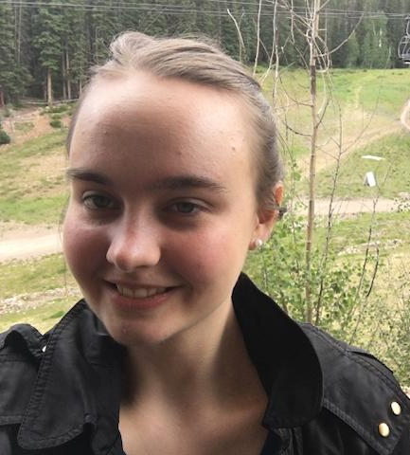
Meet the team
Igor B Miles M Disney V Melissa W

Slide 3
Value Proposition
Everything is for sale
“
“

Slide 4
Problem
You want to buy an item used, but finding someone nearby who’s selling what you need is hard—even if plenty of people would be willing to sell if asked.

Slide 5
Solution
Reclaim is a reverse marketplace where buyers post what they need and anyone nearby can fulfill their request.
Reclaim unlocks hidden supply for buyers and reduces the burden on sellers to manually list everything they’re willing to part with.

Slide 6
Overview
1
2
3
Heuristic Eval & Revisions
Thanks for the 54 suggestions!
Prototype Overview
It’s working, but we made some tough decisions.
Live Demo
We can explore it in real-time!

Slide 7
1
Heuristic Eval & Revisions

Slide 8
Summary of Violations
# Violations
(sev 3)
# Violations
(sev 4)
H1
2
0
H2
1
0
H3
3
1
H4
1
1
H5
4
0

Slide 9
Summary of Violations
# Violations
(sev 3)
# Violations
(sev 4)
H6
2
0
H7
1
0
H8
2
0
H9
0
0
H10
1
0
TOTAL
17
2

Slide 10
Most Common Violations
26%
15%
15%
H4: Consistency and Standards
H2: Match Between System & World
H3: User Control and Freedom
Despite being red, Mars is a cold place
Neptune is the farthest planet from the Sun

Slide 11
Violations: Account
No place to add profile picture (4)
H4
You can change your name frequently (3)
H5
H6
You can change your name after deal finalized (3)
R
Editing each account field takes user to new screen
We added the ability to set one’s profile picture.
While we understand how this might be confusing in a real-world platform, we think this is out of the scope of the prototype.
While we understand how this might be confusing in a real-world platform, we think this is out of the scope of the prototype.
We added an overlay pop-up for editing account fields to reduce number of screens.

Slide 12
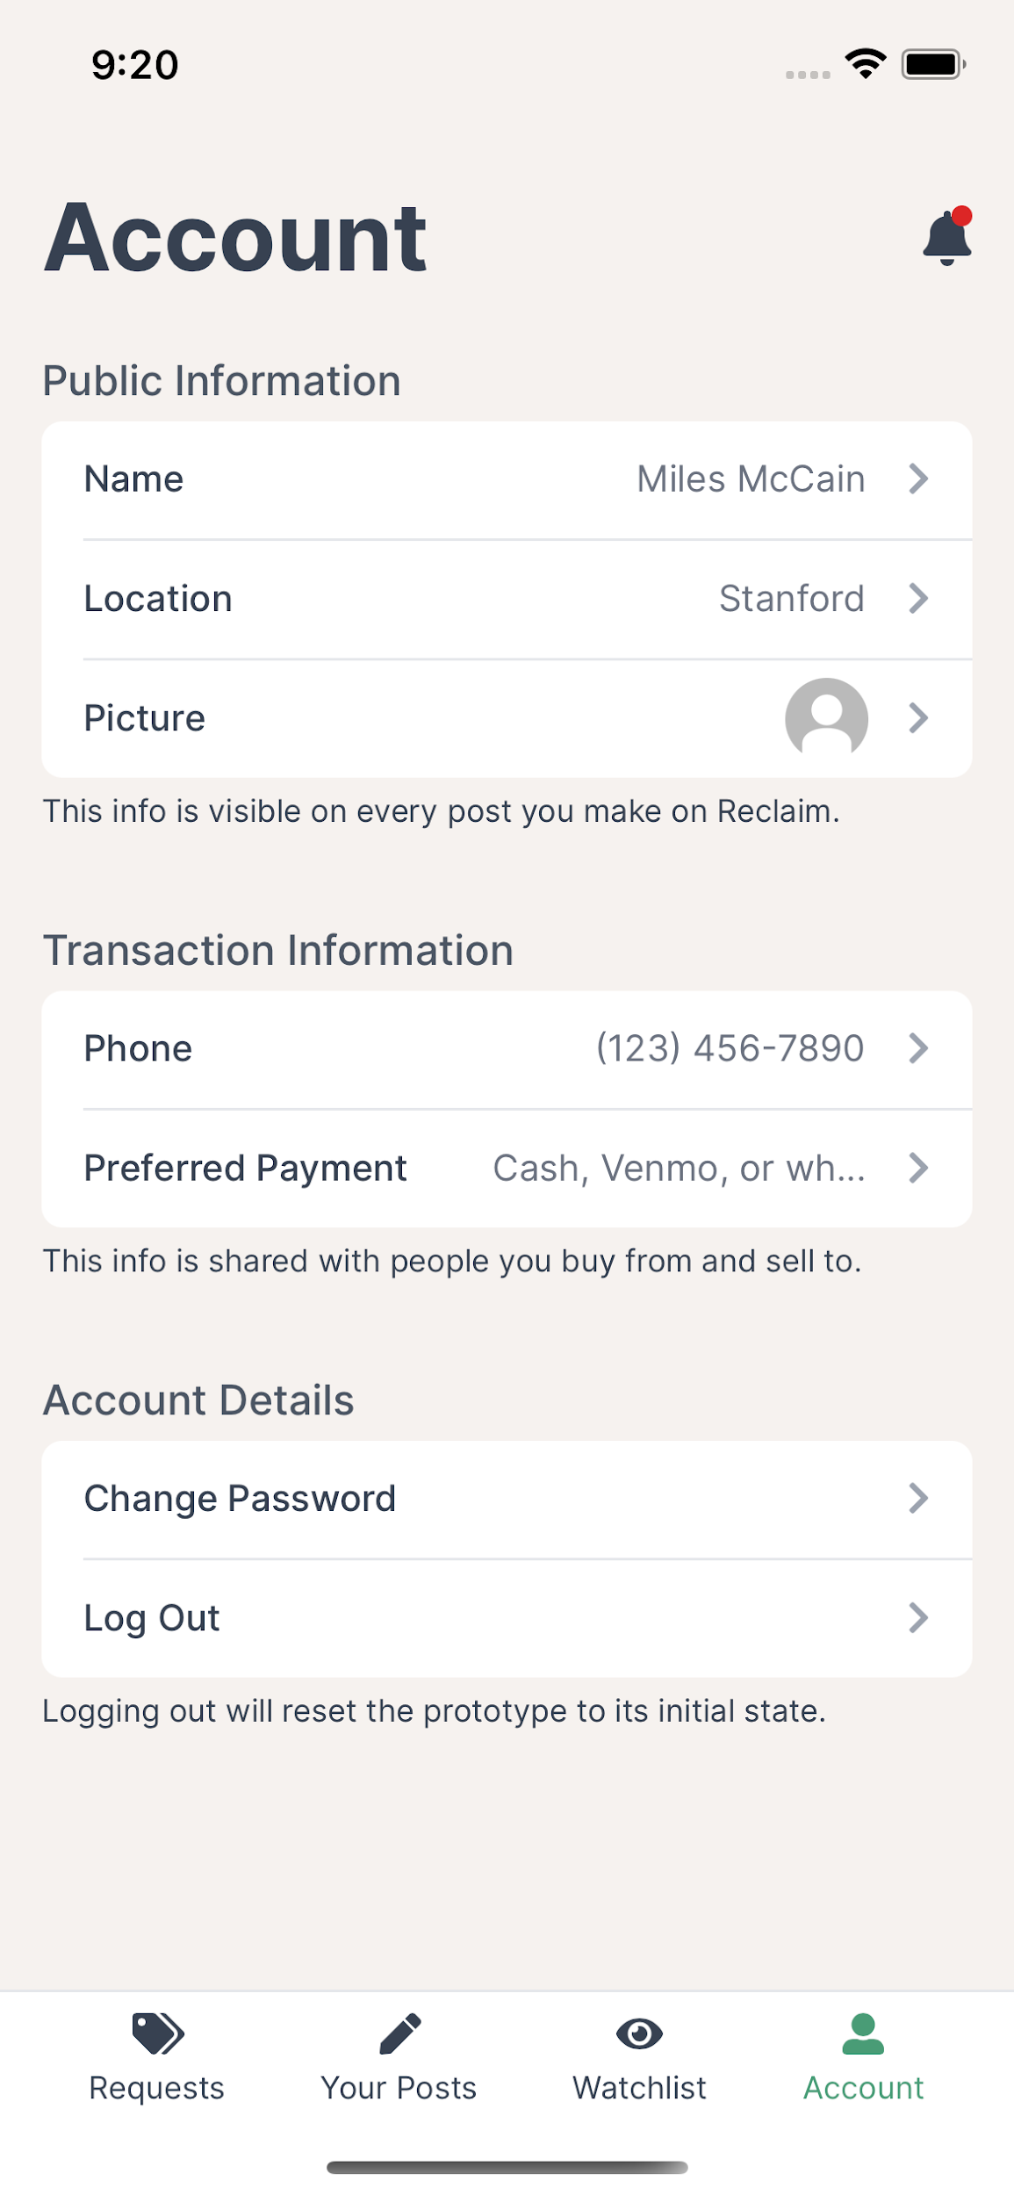
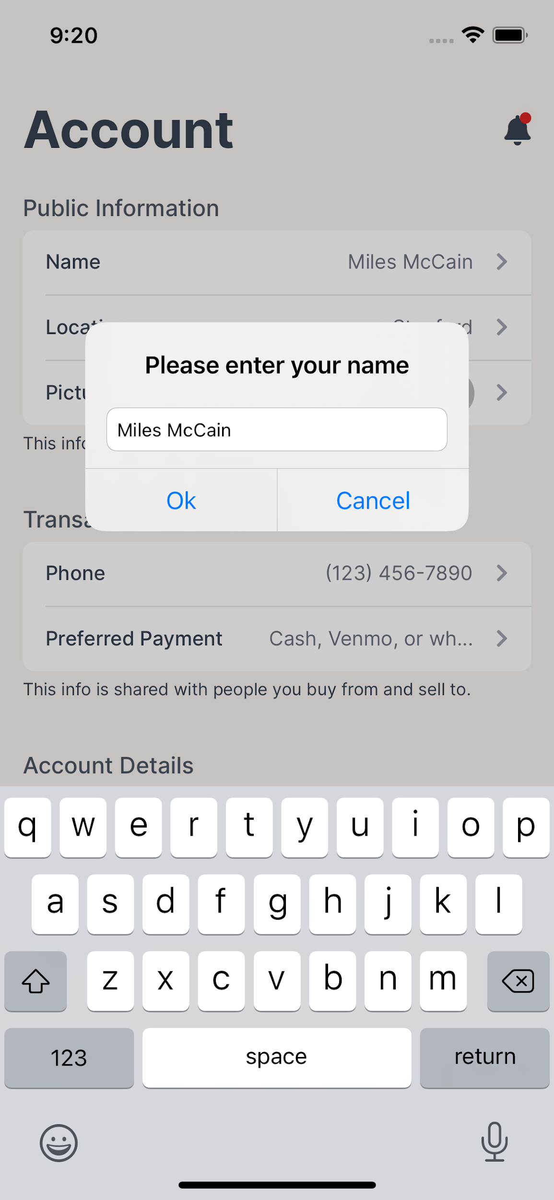
Revised Designs: Account

Slide 13
Violations: New Request
No option to select a price lower than $10 (3)
H2
No way to include photos in requests (3)
H5
H3
No emergency exit when creating request (3)
We changed the price field to have the user select the higher bound of what they’re willing to pay.
We included the ability to upload photos to requests.
We added a back button to the New Request screen.

Slide 14
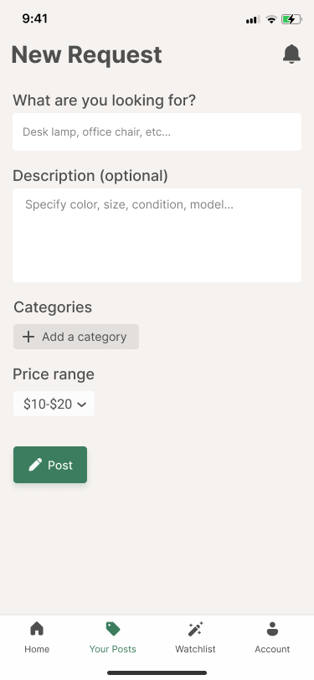
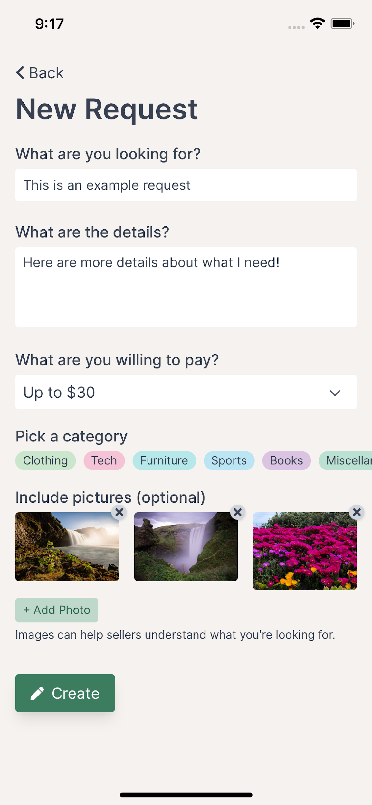
Revised Designs: New Request

Slide 15
Violations: Requests (f.k.a Home)
Home label on the bottom toolbar is unclear (2)
H1
The green “open” tag on offers is unclear (2)
H2
R
Not enough use of color
We renamed this tab “Requests” as it is more descriptive.
We never had an “open” tag on offers, but we removed it from requests on the home screen (because they are implicitly open).
We colored our tags to introduce more color in our application.

Slide 16
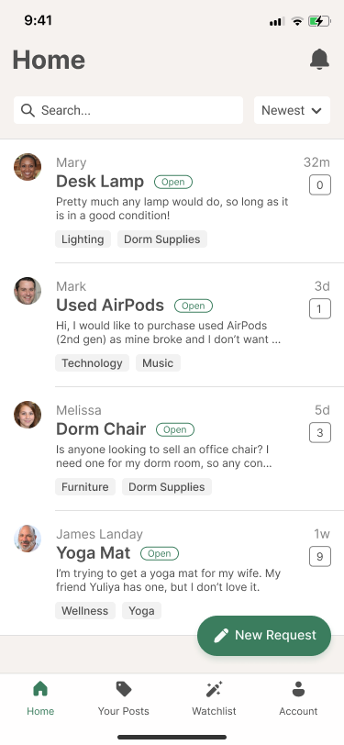
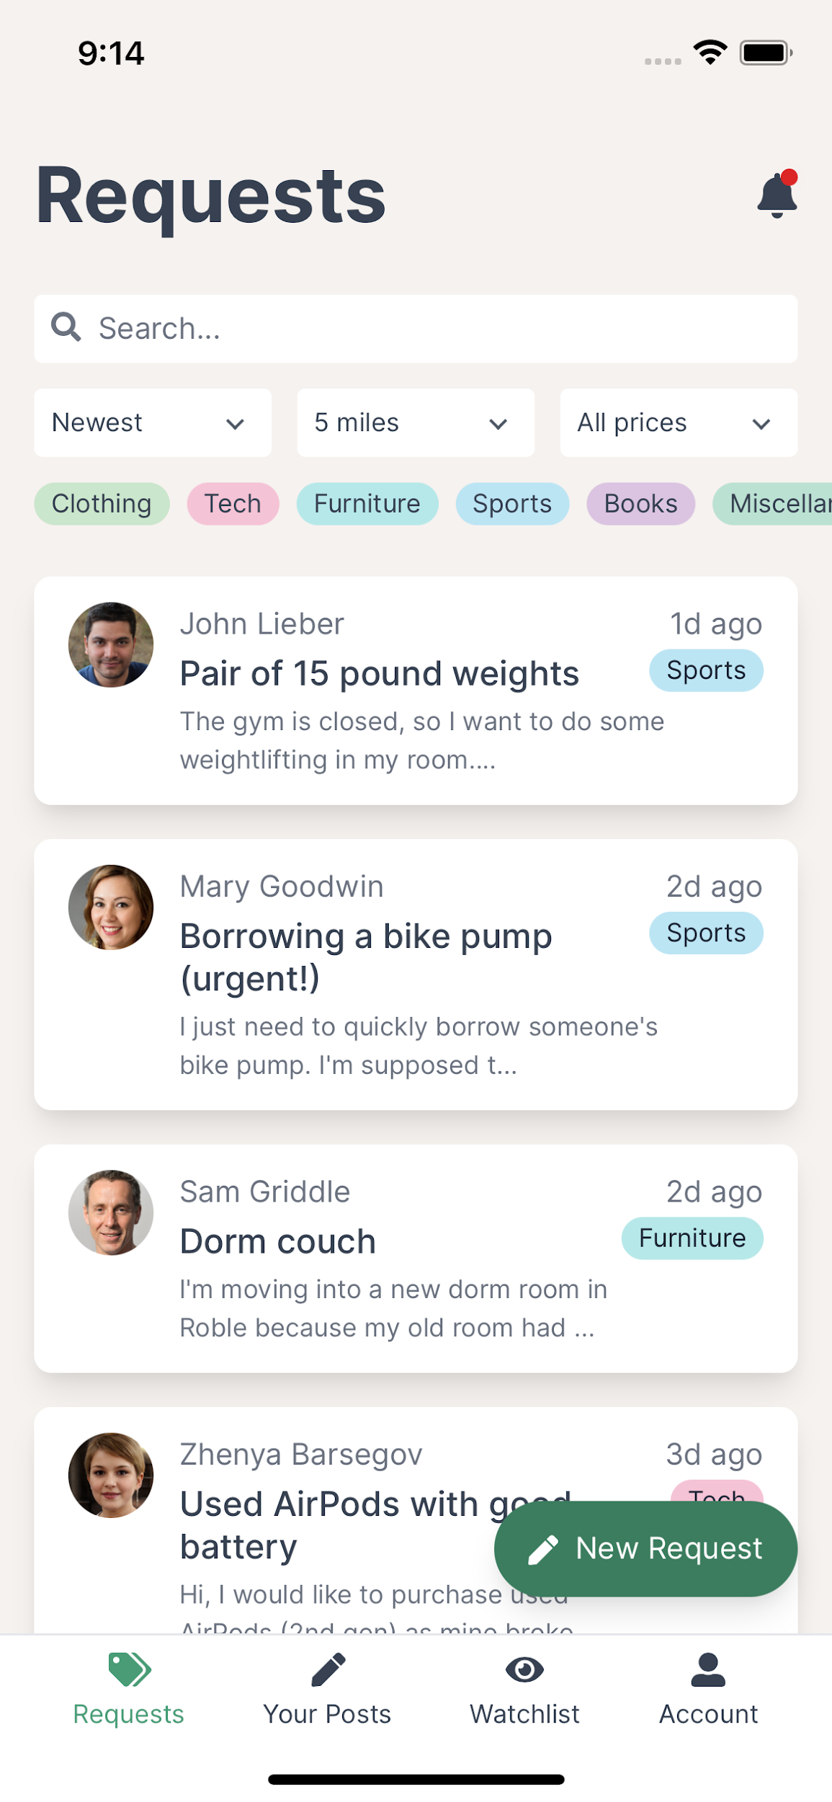
Revised Designs: Requests

Slide 17
Violations: Watchlist
H3
No emergency exit for adding to/editing Watchlist (2)
Requests has search but Watchlist doesn’t (2)
H4
H5
No confirmation before removing from Watchlist (3)
The purpose of the watchlist is unclear (3)
H5
We added a back button to this screen.
We don’t anticipate users will have more than 10 items in their watchlist; we worry search here would be unnecessary and only add complexity.
We added a confirmation message before an item is removed from the Watchlist.
We reworked the documentation to the watchlist tab explaining the feature in more detail.

Slide 18
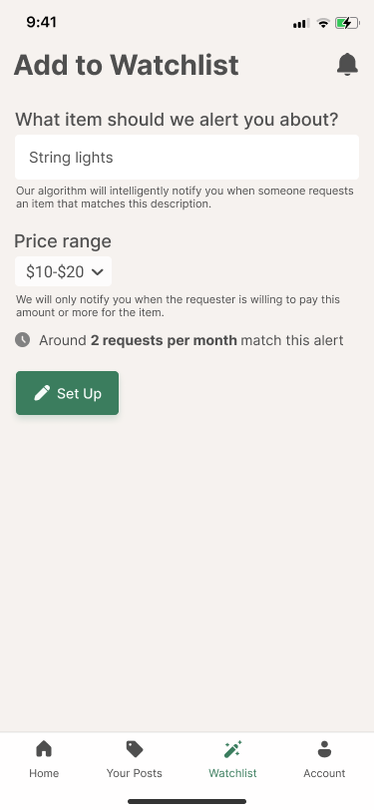
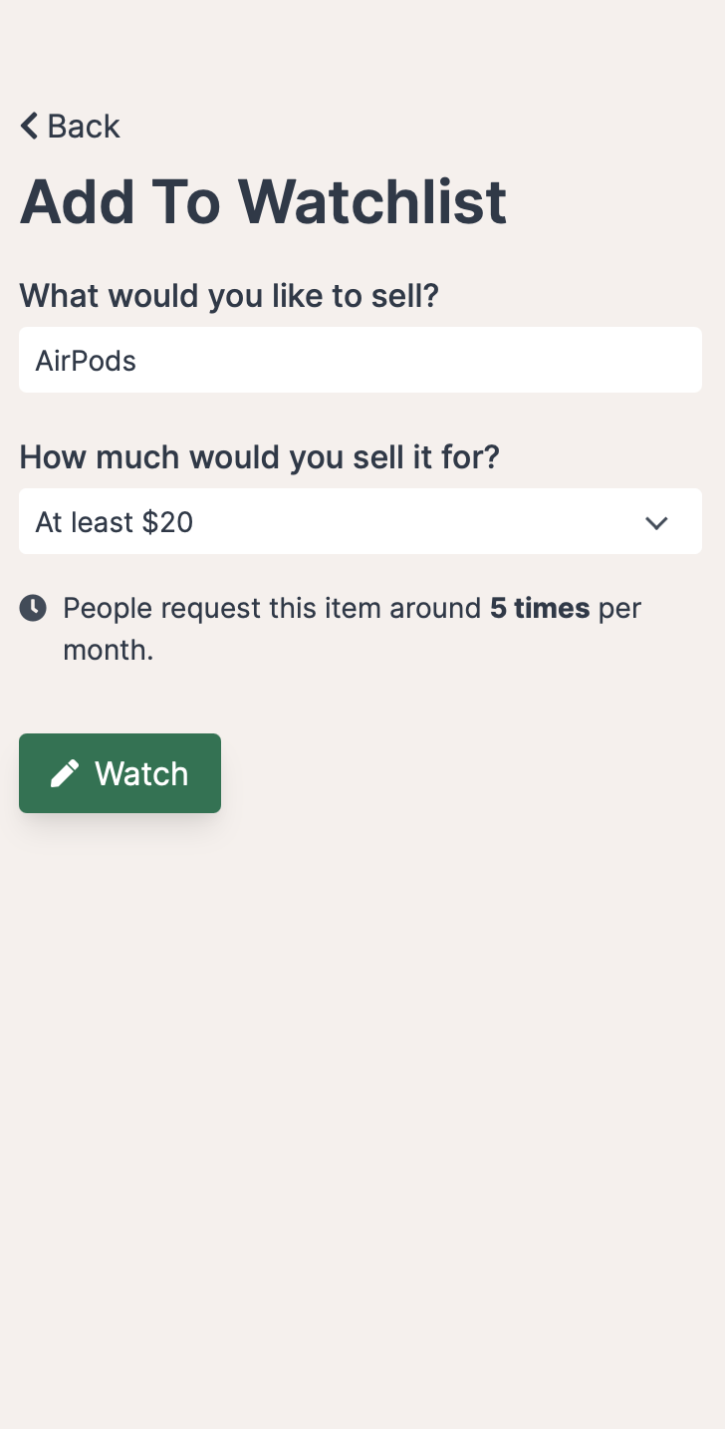
Revised Design: Add to Watchlist

Slide 19
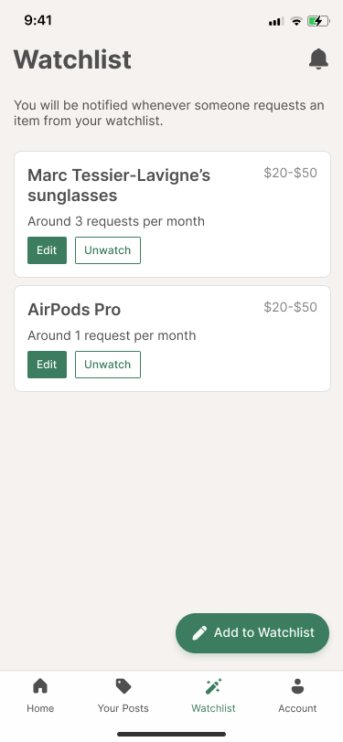
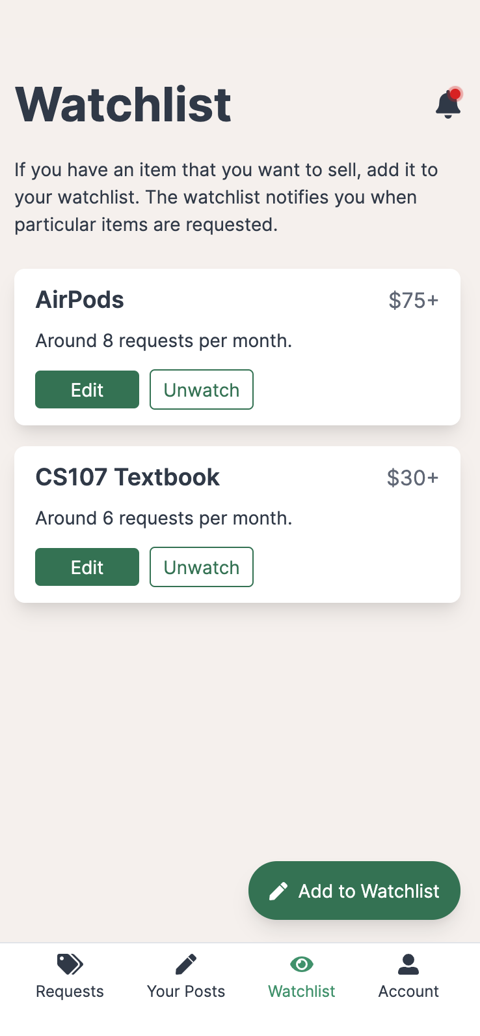
Revised Design: Watchlist

Slide 20
Violations: Notifications
H1
No notifications status indicator (3)
No emergency exit on notifications page (3)
H3
H7
Excessive number of pages for notifications (3)
No notification preferences (3)
H10
We added an overlay to the bell icon and visually distinguished unread notifications.
We added a back button to the notifications view.
There is only one view for notifications across the entire application; this is in line with other mobile apps.
There are only two sources of notifications: your own activity and watchlists. We think the system-level notifications toggle for Reclaim is sufficient (for the prototype).

Slide 21
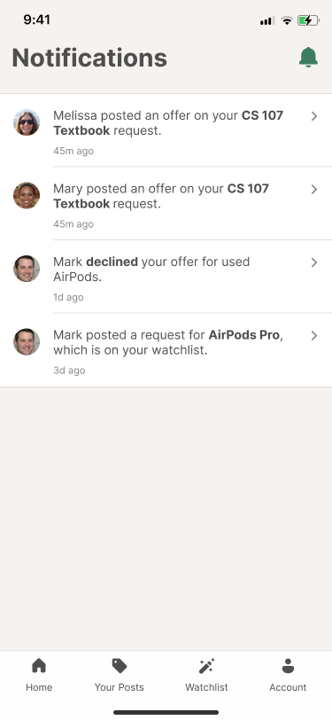
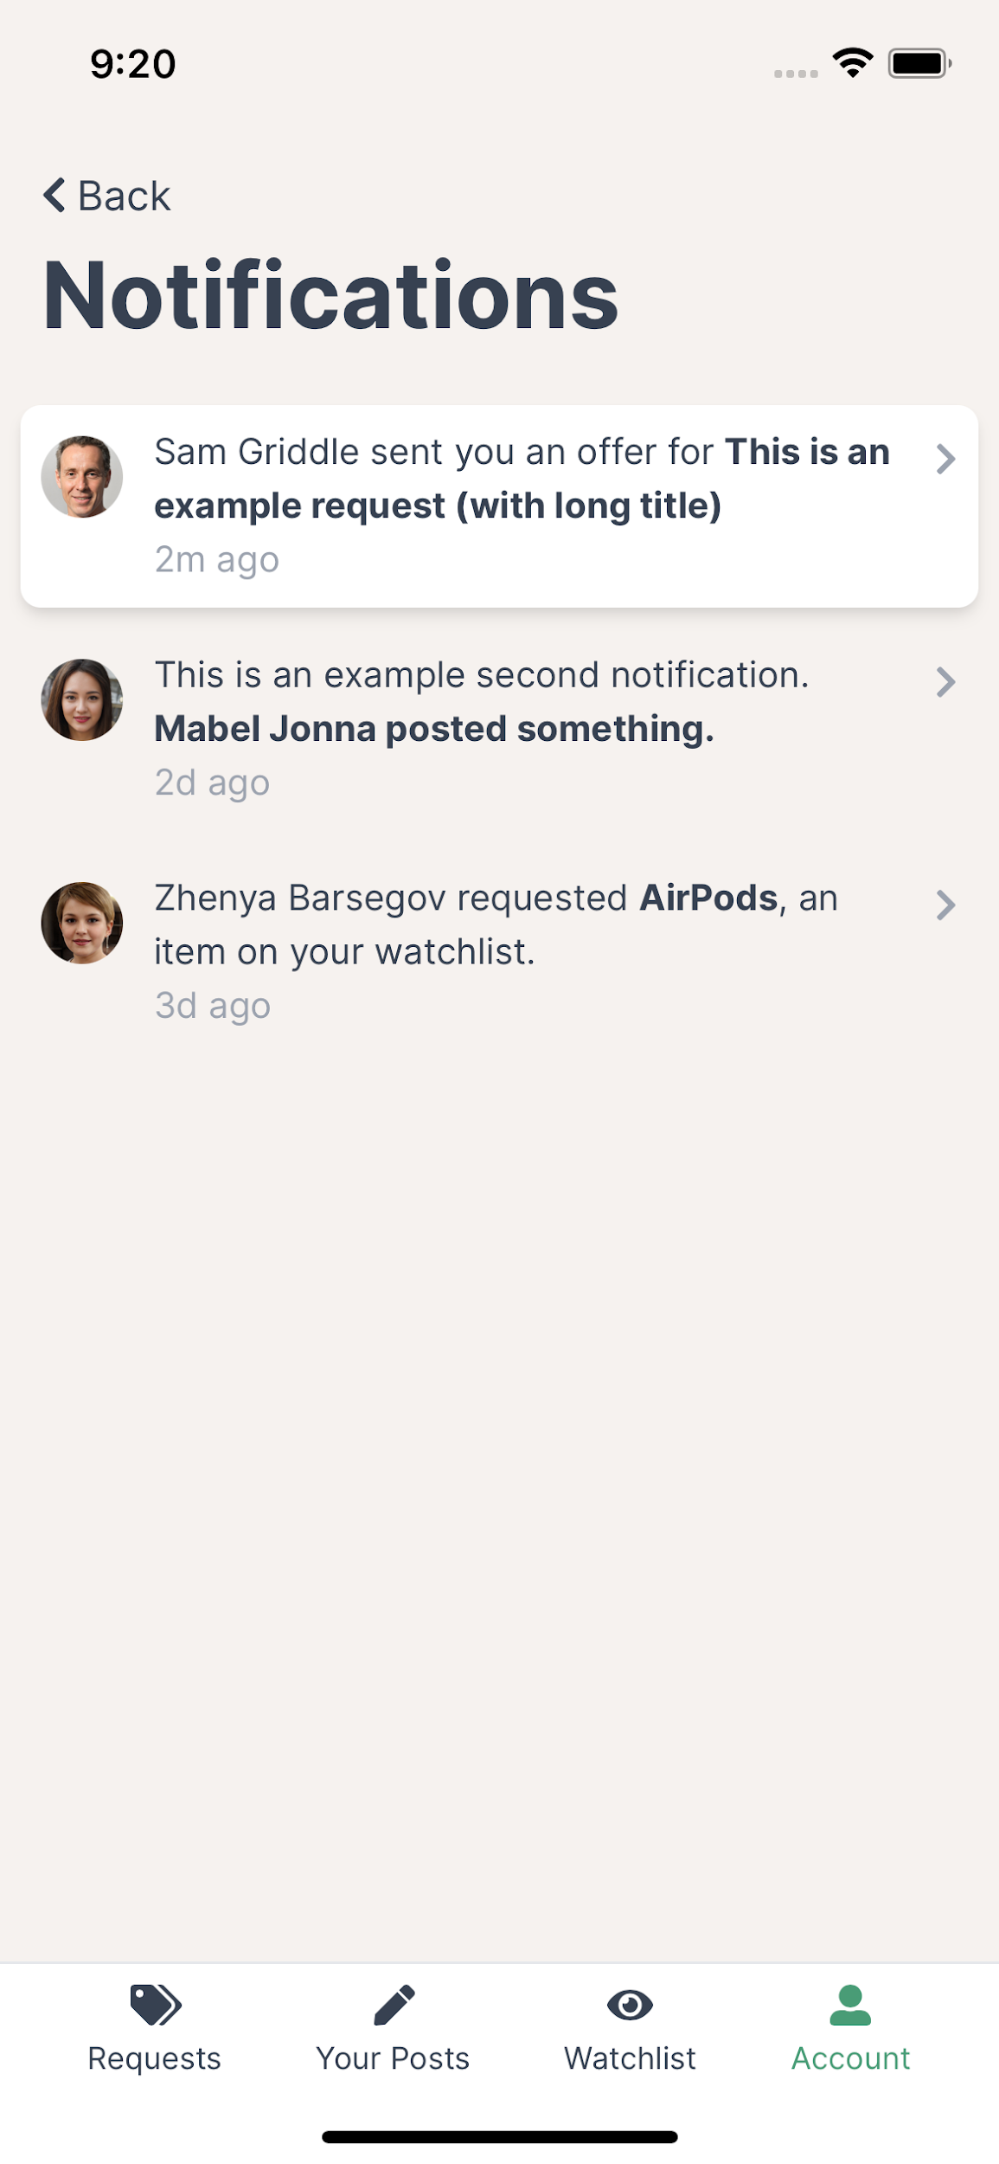
Revised Designs: Notifications

Slide 22
Violations: Offers
No guide on communicating w/ buyer after deal (2)
H10
Accepted payment methods not visible before deal finalized (4)
H3
H8
Description images are too small (3)
H4
Different button colors on accept offer pop up (3)
We added a button to allow buyer and seller to message each other after transactions.
We made it possible for buyers to view a seller’s accepted payment methods before they decide which offer to accept.
We made photo thumbnails enlarge when they are clicked.
We removed this pop up but made the buttons the same color on all of our other pop ups so that the user is not biased by the button fill color.

Slide 23
Violations: Offers (Cont’d)
Unclear what “Report a Problem” button does
R
Conversation is difficult to follow (3)
H6
No “unread” dot next to new offers (3)
H1
H8
There is too much text (3)
We removed this button as it confused our users and is outside the scope of the prototype.
We incorporated more whitespace and depth into our request view, but we think chronological is the way to go. (Also not sure about severity.)
New offers always appear at the top of the request view; we worry that adding additional indicators will make our interface cluttered for only marginal benefit.
We reworked our interface to have more whitespace, but we think that the remaining text is thoughtful and necessary.

Slide 24
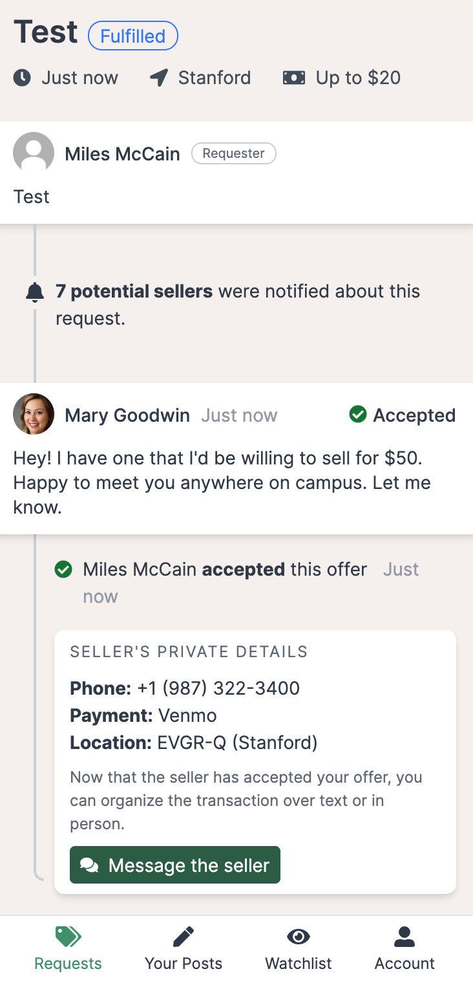
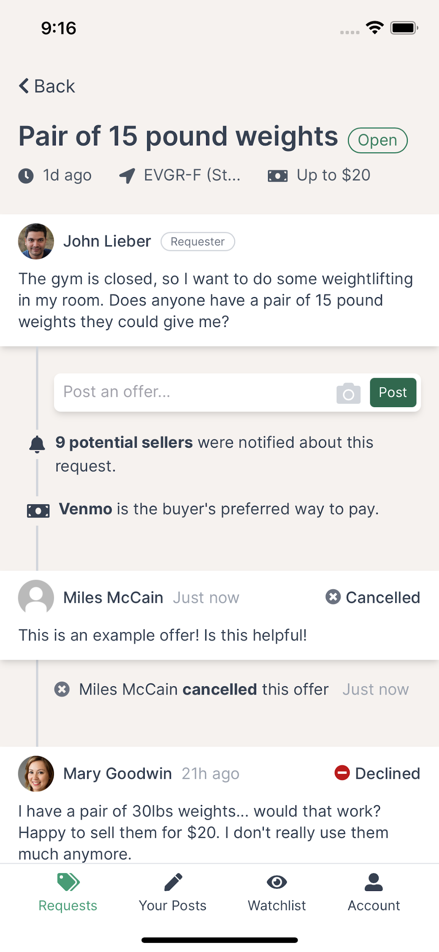
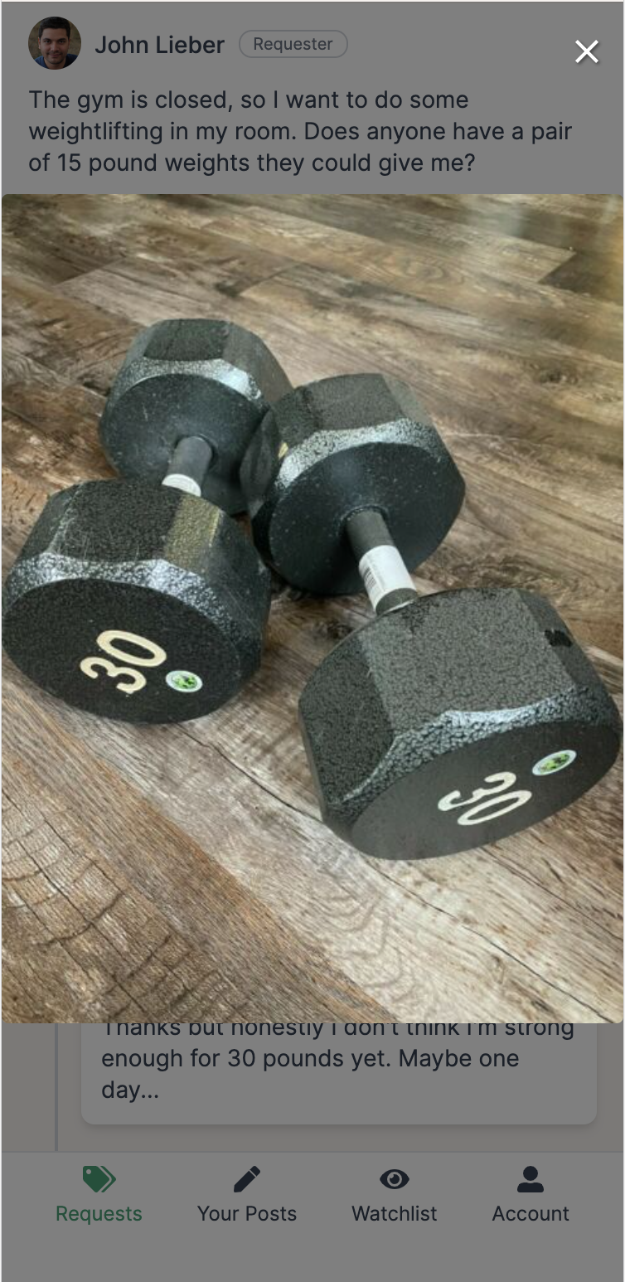
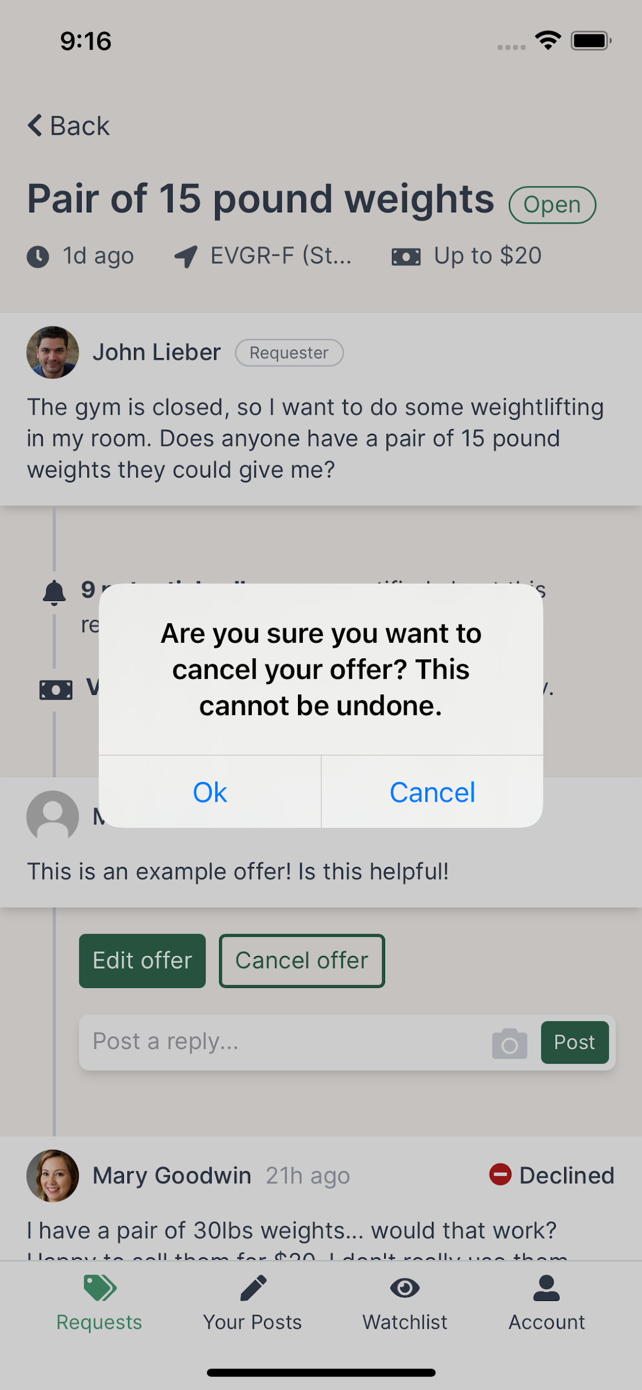
Revised Designs: Offers

Slide 25
Violations: Your Posts
Searching and filtering is included on “Home” screen but not on “Your Posts” (2)
H4
Seller name / payment difficult to find (2)
H6
The “Your Posts” already has searching functionality; we think adding additional filtering is unnecessary given the lower volume of posts on the ‘Your Posts’ view.
Clicking on an accepted offer now brings you directly to the transaction details.

Slide 26
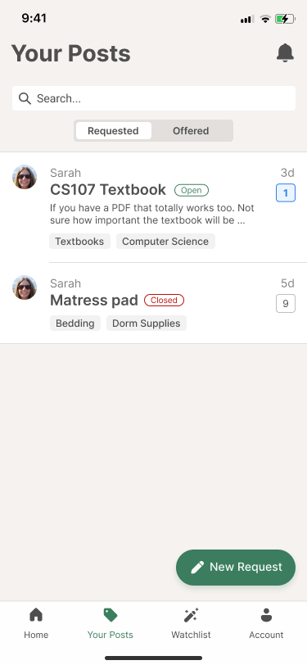
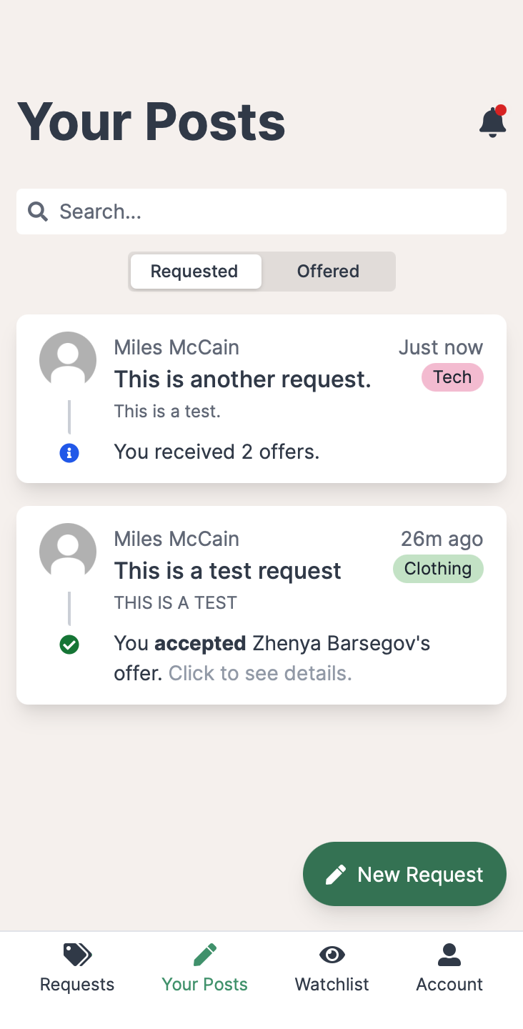
Revised Design: Your Posts (Requested)

Slide 27
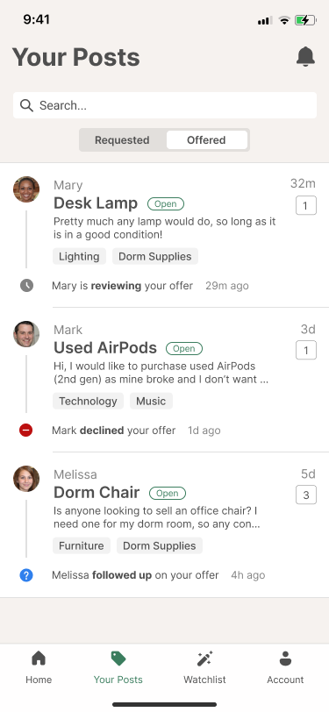
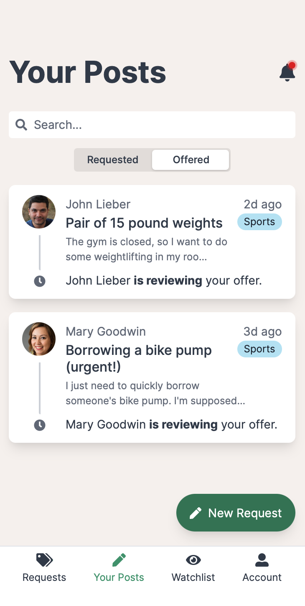
Revised Design: Your Posts (Offered)

Slide 28
2
Prototype Overview

Slide 29
General Changes
You can now only accept one offer
“Withdraw offer” is now “cancel offer”
More intelligent sorting on request page
No more collapsing threads; smart ordering is sufficient
Requests now only have one category
Removed # of offers on request card

Slide 30



Our Tools
Vue.js
Capacitor
Xcode

Slide 31
Implemented Features
Account creation and management
Creating requests, including images (task 1)
Posting offers (task 2)
Viewing and responding to offers (task 3)
Notifications, for the most part
Adding items to the watchlist & editing (task 4)
Data persistence while the user is logged in.
On-device compression of images!

Slide 32
Unimplemented Features
Comprehensive default “demo” content
Native notifications (TBD)
Animation tweaks
Simulate having one’s offer accepted
Small bug fixes
Detailed README so others can run

Slide 33
Plan to Finish
“Bugathon” this weekend
Writing more demo content this weekend
We’re in a good place!

Slide 34
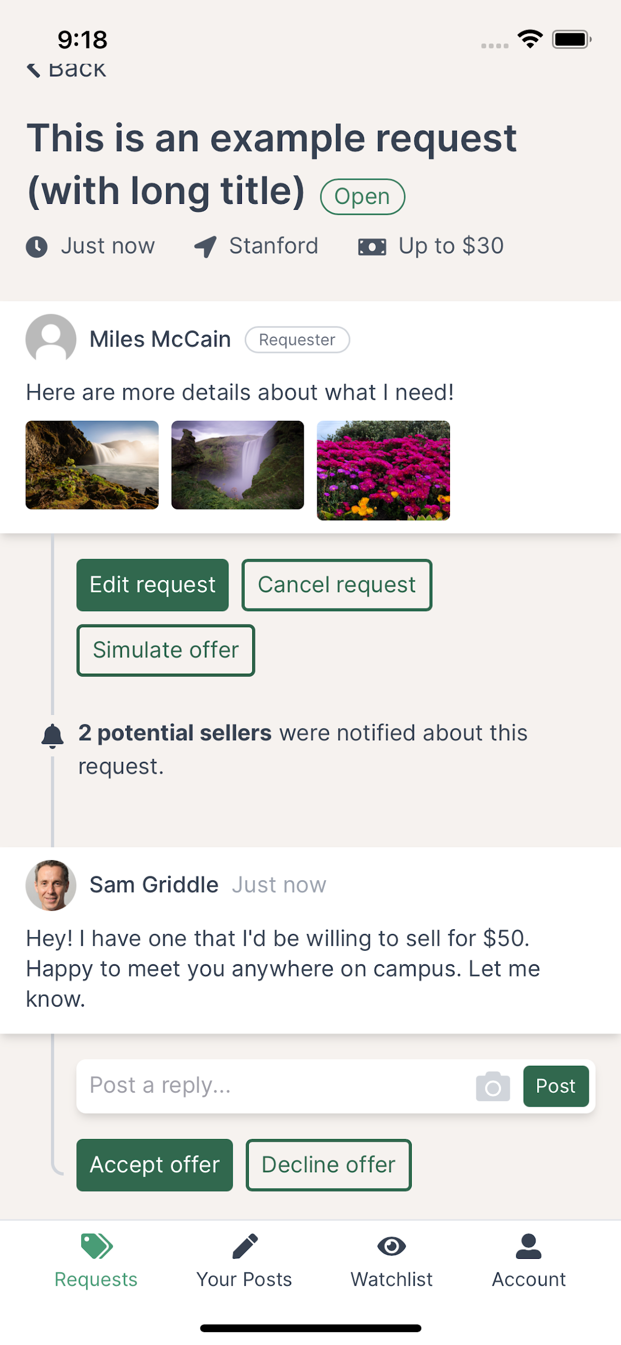
Wizard of Oz Techniques
“Simulate an offer” → get a vague offer
When you post an offer, seller will “magically” respond and/or accept/decline
We “autodetect” the user’s location to be Stanford
Number of users notified is random; same for requests/month in watchlist.

Slide 35
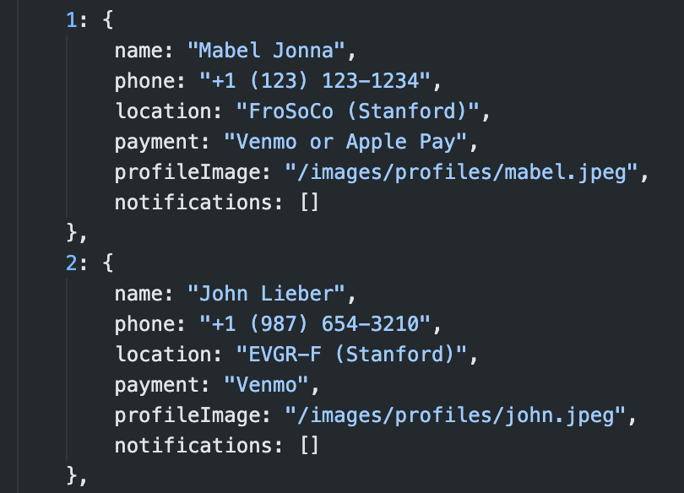
Hard-Coded Data
The starter content is all hard-coded, but also interactive.
Fake interactions are hard-coded (but randomized).
It’s all local; there is no server here. (Though incorporating wouldn’t be too hard).

Slide 36
3
Live Demo

Slide 37
Summary
We’re nearly there!
All four tasks implemented.
This weekend: hard-coded content and bug fixes.
Next week: report & poster.
Thanks for all the violations & feedback!

Slide 38
Questions
Should we incorporate a “user reputation” feature?
Because the user will be using the app when all notifications are sent, should we automatically mark them as read?
...anything else?

